Slide 1

‘PIVOT & PUBLISH’ TABLES TO WORD USING ONLY R
Creating, editing, and publishing tables with R
is easier than you think
Notes:
Hello, my name’s Burnette and I work in the Construction Industry Research & Policy Center here at UT’s College of Business.
I’m an R beginner and want to share with you the pleasant surprise I’ve gotten using R to create tables for reports in Word format.
I’m a huge fan of Excel, but I’ve found R to be very powerful for this particular task.

Slide 2
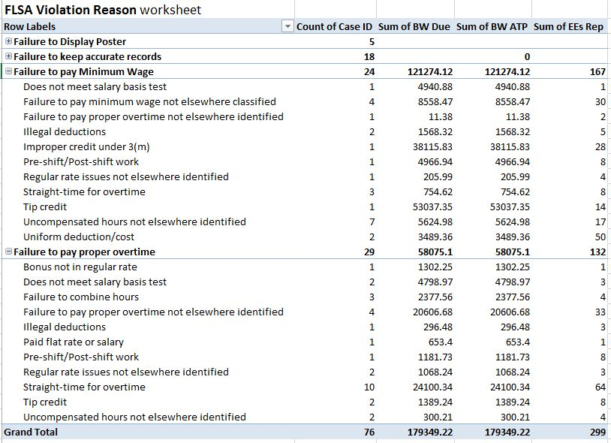
Excel pivot table
Notice this type of detail in Excel.
Notes:
Here’s an Excel pivot table. It was fairly easy to make and it’s a logical layout. But notice how it reports the data ‘as is’, which isn’t always as clean or descriptive as you’d like the final product to be.

Slide 3
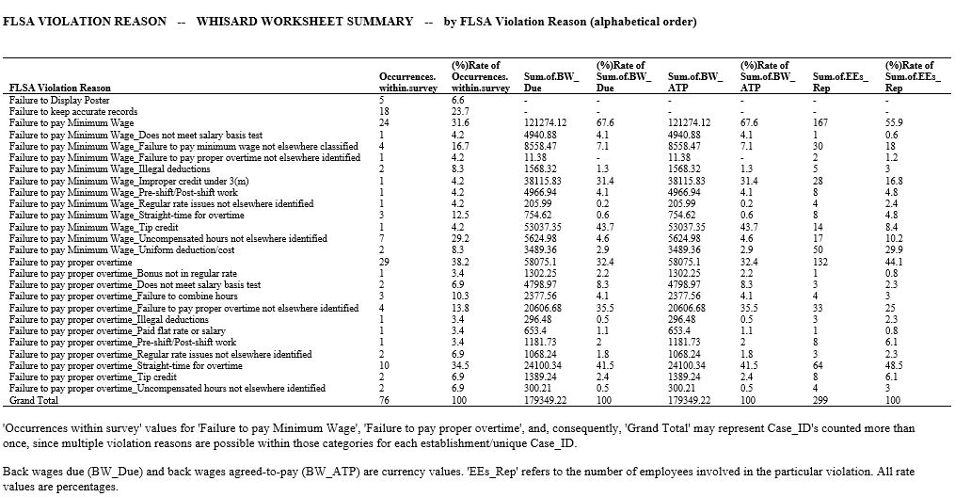
R’s output
Notes:
Here’s the same pivot table in R once I realized how much more information I needed to present. In one step, not only I was able to do that, but I also renamed columns and replaced zero’s and blanks with more consistent formatting.

Slide 4
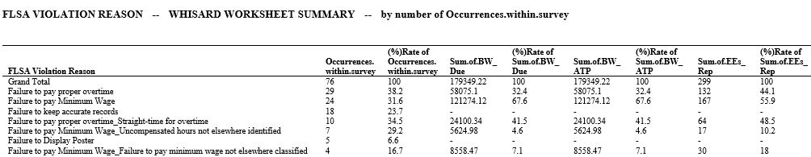


More R output: sort by column value
Notes:
AND I was able to simultaneously generate more tables with the same content, just sorted by decreasing values for various columns.

Slide 5
R packages for pivot tables
library(reshape)
library(reshape2)
melt()
cast()
acast()
dcast()
Notes:
To create these types of pivot tables, the reshape() packages containing melt() and cast() functions may be used. You can read more about these in R help.

Slide 6
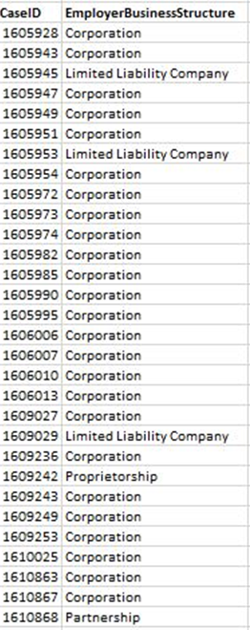
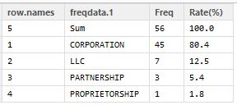
Example STEP 1: create a frequency table
freqdata.1 <- mydata$EmployerBusinessStructure
CHAR1 <- table(freqdata.1)
CHAR1DF <- as.data.frame(CHAR1)
rownames(CHAR1DF) <- CHAR1DF$freqdata.1
CHAR1_total <- addmargins(as.table(as.matrix(CHAR1DF[-1])), 1)
CHAR1_total <- as.data.frame(CHAR1_total)
CHAR1_total <- subset(CHAR1_total, select= -Var2)
library(gdata)
CHAR1_total <- rename.vars(CHAR1_total,from="Var1",to="freqdata.1",info=FALSE)
CHAR1_totalRate <- within(CHAR1_total, "Rate(%)"<- round((Freq/tail(Freq,1)*100), digits=1))
CHAR1_totalRateSort <- CHAR1_totalRate[do.call(order,data.frame(CHAR1_totalRate$Freq,decreasing=TRUE)),]
mydata
Notes:
For now, though, let’s look at a more basic example.
Here I want to count how many establishments in my survey are assigned a particular business structure. I’ll use the table() function.
Then I can add a grand total value using addmargins(). This is only one of several ways to do it. [colSum]
Columns can be renamed using the gdata package.
Rates can be calculated and rounded to one decimal place.
And, the table can be sorted by decreasing frequency using do.call() and ‘order’.
RStudio’s view of the result is shown here on the right. [automatic row.names]

Slide 7
STEP 2: publish to .doc file
library(rtf)
FrequencyTables <- “~/R_2010HillsCoFL_FullSvcRest/Survey_Reports/FrequencyTablesCatRates.doc“
rtf <- RTF(FrequencyTables, width=8.5, height=11, font.size=12, omi=c(0.5, 0.5, 0.5, 0.5))
# outer margins = (bottom, left, top, right)
addHeader(rtf, title="FREQUENCY TABLES -- CATEGORICAL DATA")
addHeader(rtf, title="freqdata.1 = Employer Business Structure")
addTable(rtf, CHAR1_totalRateSort, header.col.justify="L", col.justify="L", font.size=9, row.names=FALSE, NA.string="-")
addNewLine(rtf)
addNewLine(rtf) # addNewLine(rtf, n=2)
addPageBreak (rtf) # add new page properties here
addSessionInfo(rtf)
# setFontSize(rtf, 9)
addParagraph (rtf, "R script filename: rtf3_FrequencyDataCat_WHISARDrates.R\n")
done(rtf)
Notes:
Now we’re ready to publish the table to Word using the rtf package. [publish vs. ‘print’]
To do this, tell R where you want the file to be stored in your directory.
Set page properties, add headings, lines, and paragraphs, and even insert page breaks that will allow you to change the properties of the next page if you want to.
You can also add R session information which can be helpful as an archive detail.
I’ve had some problems using addNewLine and setFontSize arguments in my environment. You’re supposed to be able to tell addNewLine n=2 or 3 etc., but here I’ve just repeated the entries. And you’re supposed to be able to tell setFontSize what point size you want your text to change to within the document. [tested 2 x versions, R & rtf]

Slide 8
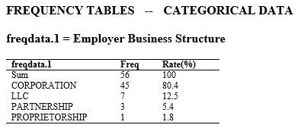
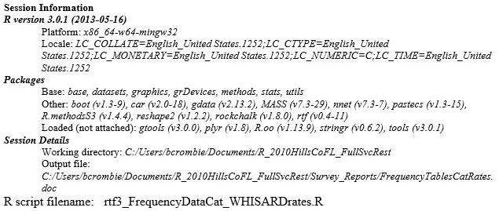
Example output
I could have eliminated this line and just renamed the first column in the table, but I anticipated using this script for other datasets and wanted to make it easy to edit.
Notes:
This is the final output.
I could have presented the table a slightly different way, but I anticipated using the R script for a lot of different datasets and wanted to make editing easy later. That’s why you see generic column headers.

Slide 9
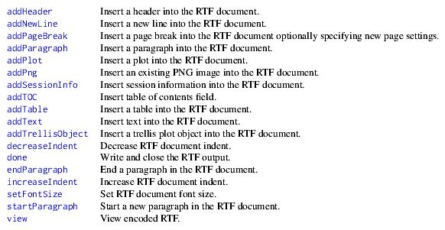
‘rtf’ methods
Notes:
‘rtf’ isn’t just limited to tables either. You can include other objects like plots and images.
There’s a Table of Contents function that looks pretty useful, too, and I plan to investigate that at some point.

Slide 10
More formatting tips
rtf <- RTF(QuickSummaryReport, width=11, height=8.5, font.size=10, omi=c(0.5, 0.5, 0.5, 0.5))
addHeader(rtf, title="PRELIMINARY SUMMARY STATS FOR all establishments")
addTable(rtf, SummaryTblAll, col.widths=c(1.5,rep(1.2,7)), col.justify="L",
header.col.justify=NULL, font.size=8, row.names=FALSE,
NA.string= "-", space.before=NULL, space.after=NULL)
addNewLine(rtf)
addPageBreak(rtf, width=11, height=8.5, omi=c(0.5, 0.4, 0.5, 0.4))
You can specify different column widths, different column and header alignments, font size within the table, whether to keep the row.names column or not, etc….
addPageBreak defaults back to portrait (vs. landscape) if not specified. You can change the outer margins of the following page here, too.
Notes:
More tips for making your output look nice include:
Specifying different column widths, different column and header alignments, font size within the table itself, and whether to keep the row.names column or not.
Here we have a script for a table with 8 columns: the first column’s width is 1.5, and the remaining 7 are 1.2; all column data are aligned left; and I’ve chosen to replace NA’s with a symbol.
One time I experienced table text acquiring whitespace through rtf, which prevented proper alignment. It probably had something to do with the original format of my source data, but I was able to fix it by including trim functions in the script.
This document begins in landscape mode, so note that addPageBreak defaults back to portrait orientation if you don’t specify document width & height again.
You can change the outer margins of the following page here, too, BUT, you can’t set a new font size within page break at this time (or at least I’ve not gotten that to work).

Slide 11
I can do this in Excel. Why use R?
PRO’s:
Only one step to your end result once R script is established -- good for routine tasks
Potentially more sophisticated output -- add rows/columns for specific calculations on a whim
Changes to dataset are translated quicker -- just rerun the script after editing source data
Unintentional formatting eliminated -- no warped settings when linked or pasted from Excel
Clarification of headers unnecessary -- R script can include renaming abbreviations
CON’s:
May need to edit table in Word for visual emphasis or ‘flare’ -- rtf lacks ability to bold or highlight
Notes:
IN SUMMARY, Excel is easy, but you don’t realize how many steps are involved until you create the same thing in R.
Excel sometimes requires you to completely start over if you find an error in your source data, but with R, once you’ve made changes, rerunning a script takes a matter of seconds.
If you’ve ever linked an Excel table to a Word or Publisher document, and after reformatting your Excel spreadsheet, the linked table got warped badly, you’ll be happy to know this won’t happen using R.
Also, it allows you to easily rename columns or rows as the table’s being created so you don’t have to worry so much about labels in your original dataset.
The only drawback to the process I’ve described is that rtf doesn’t have the ability to bold or highlight text yet, so you may need to add flare once you’re in Word.

Slide 12
Finally
Many thanks to Josh Callaway of OIT’s research support staff for introducing CIRPC to rtf.
If you’re interested in learning more about how we’re applying R to survey analysis or would like to share suggestions, contact us at cirpc.bus.utk.edu.
Notes:
Finally, I want to mention Josh Callaway of OIT’s research support staff and thank him for introducing CIRPC to rtf. It’s my understanding that Josh played a major role in developing the package and we’re grateful for that.
If anyone is interested in learning more about how we’re applying R to survey analysis, or you have suggestions to share, please visit our website and shoot us an email from there. We’d love to hear from you.

